Slide 1
Experiment of Amoeba grazing control effect on Microcystis
- By Kunyu Yang (Koi)

Slide 2
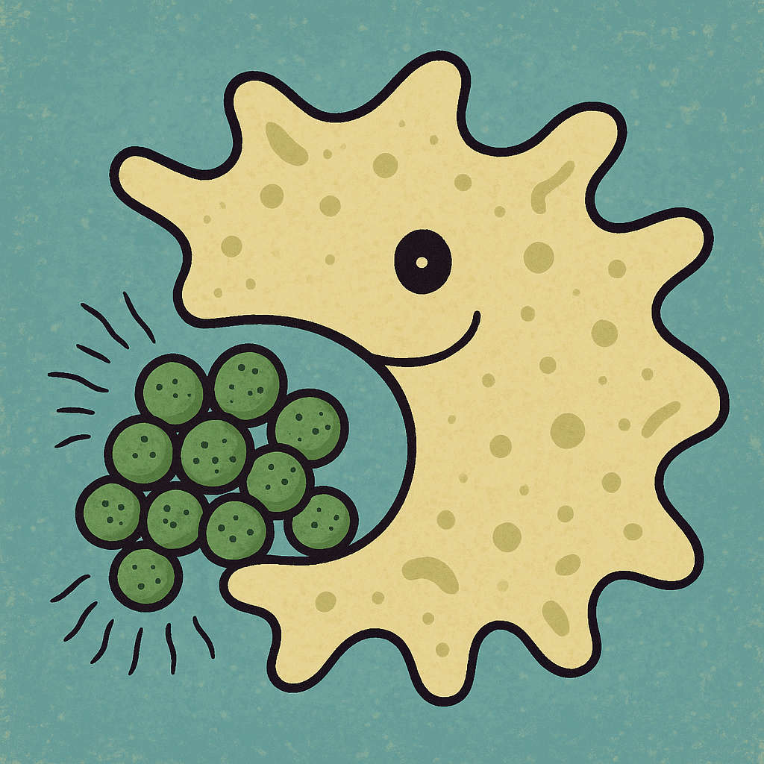
Research question
4 strains of Microcystis from Lake Erie, 2 toxin-producer (LE21 22.1 ISO1 MC+; LE21 52.2 ISO3 MC+) , 2 non-toxin-producer (LE21 22.1 ISO2 MC-; LE21 52.2 ISO3 MC+)
Amoeba Vannella – isolated MC predator (A22.3-1, 1/7/25)

Slide 3
Research question
Primary question: Up regulation in food chain not observed ?
Primary method: Feeding experiment with modified factors

Slide 4
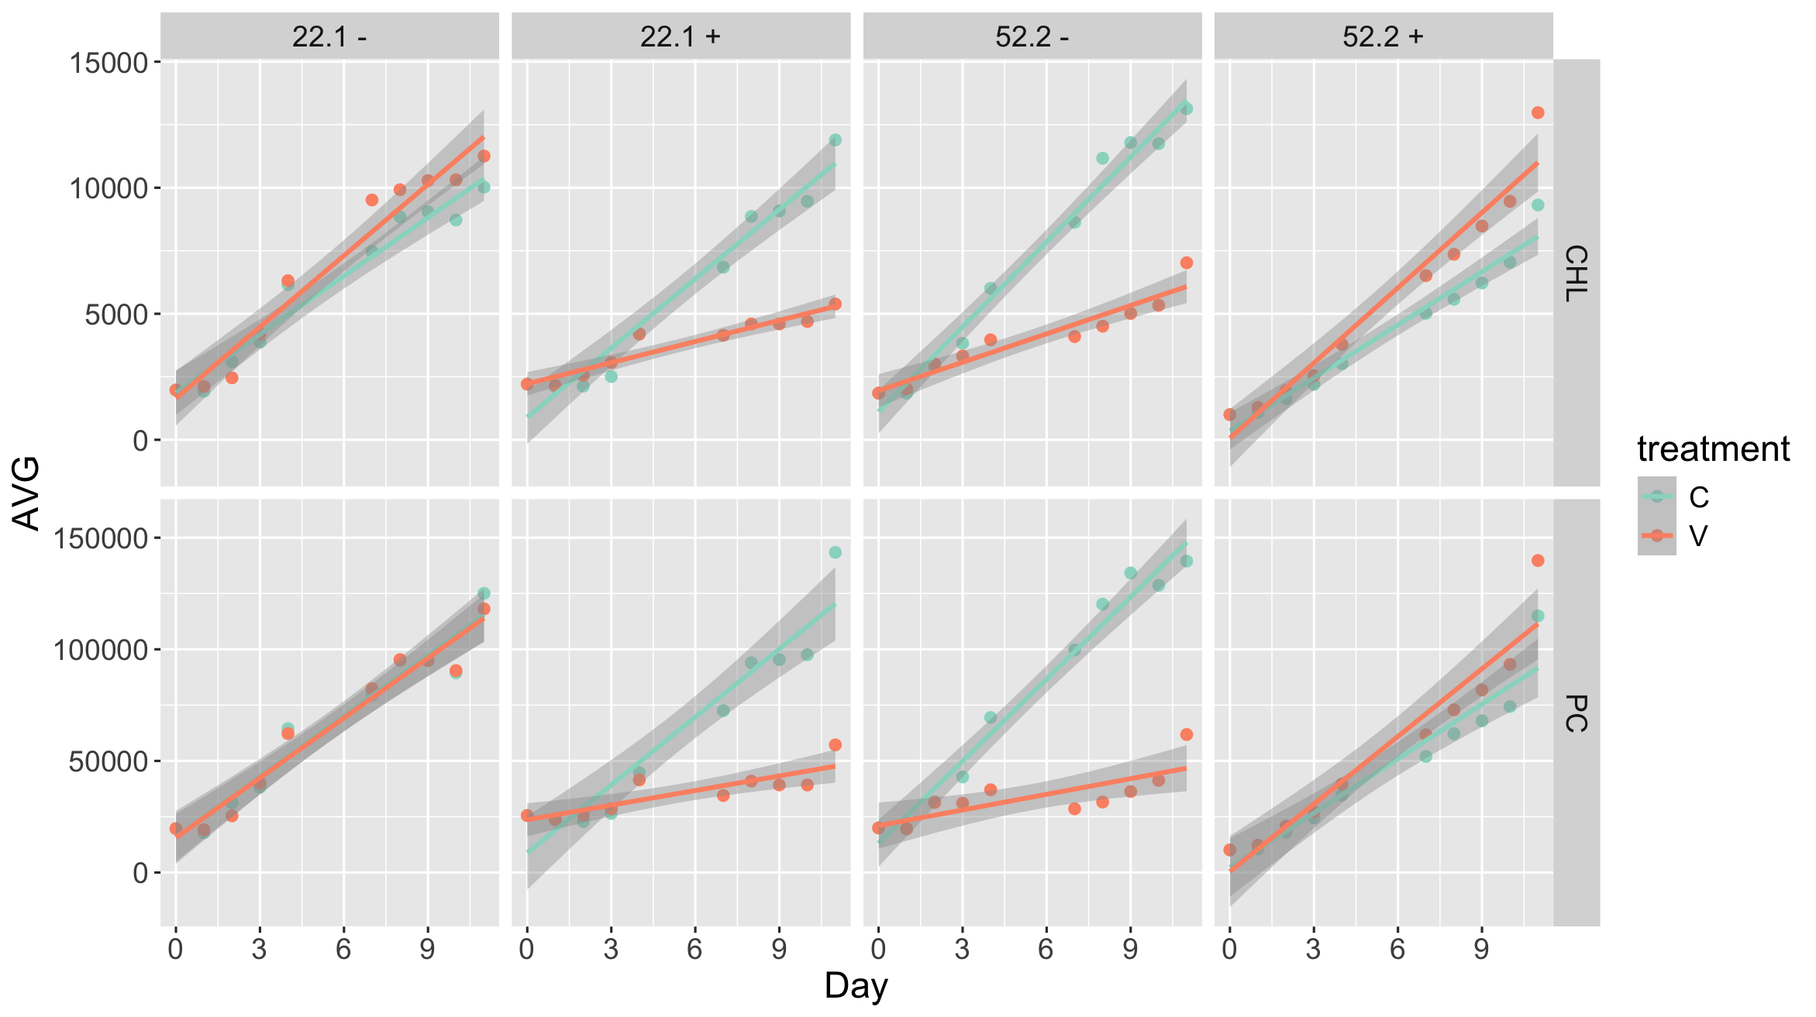
Preliminary EXP 1

Slide 5
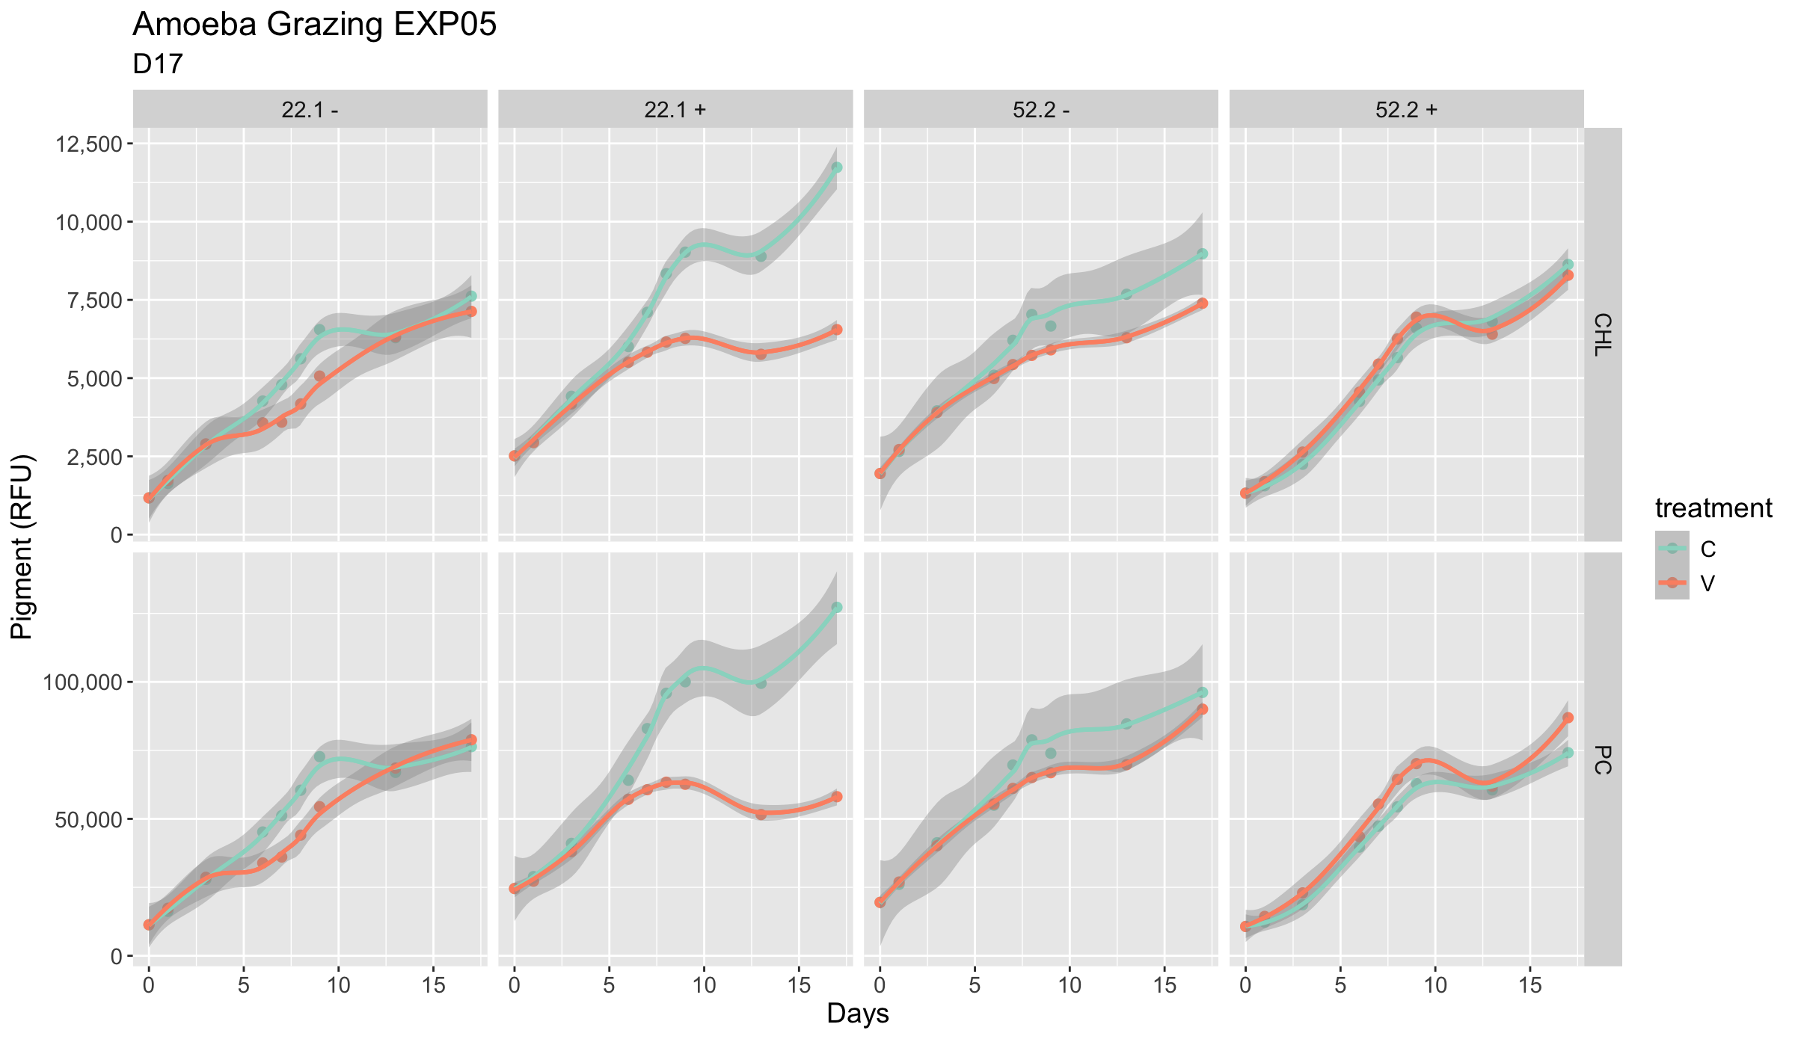
Preliminary EXP 2

Slide 6
New question !
Could higher Amoeba density bring biomass reduction to “poor” food source?

Slide 7
EXP design and data collection
2 MC strains 22.1 – and 52.2 +
Incubate with Amoeba stock culture (1X dilution), 5X and 10X
8 days duration, pigment measurement per 2 days (CHL-a and Phycocyanin)
16 samples include control groups without Amoeba

Slide 8
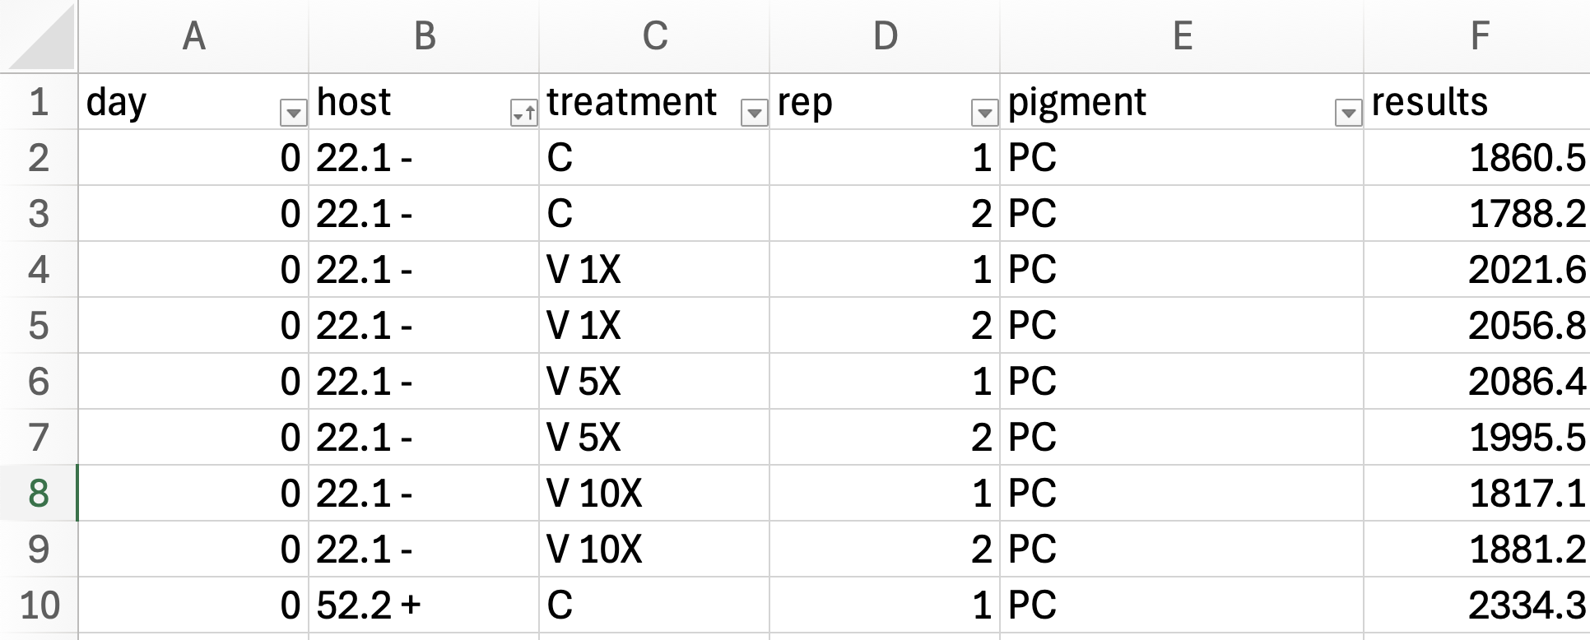
Raw datasets

Slide 9

Visualization of growth curve - code

Slide 10
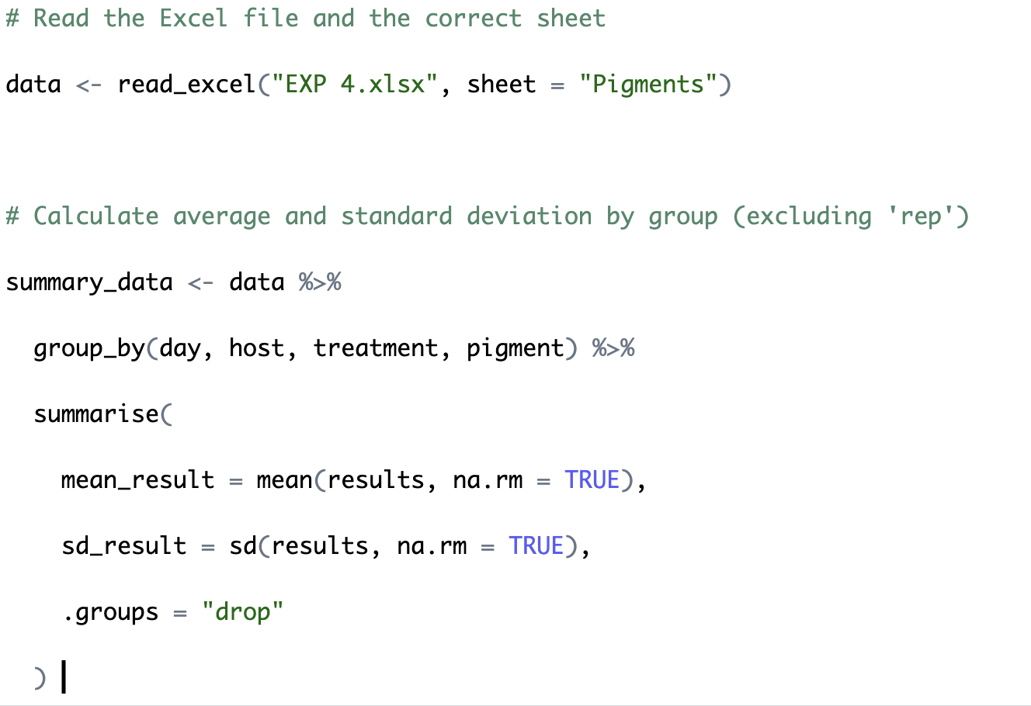
Visualization of growth curve - code

Slide 11

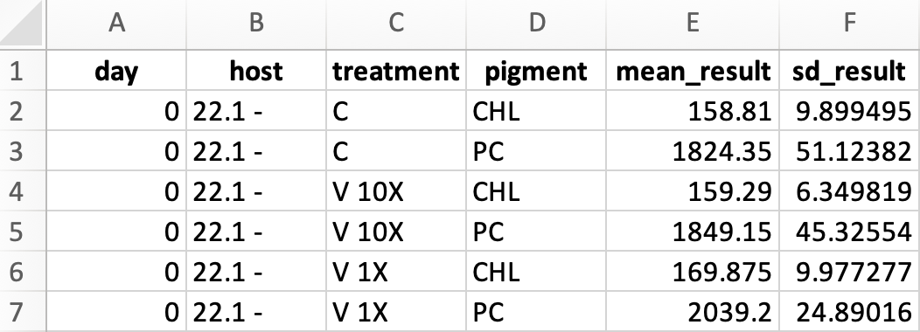
Visualization of growth curve - code

Slide 12
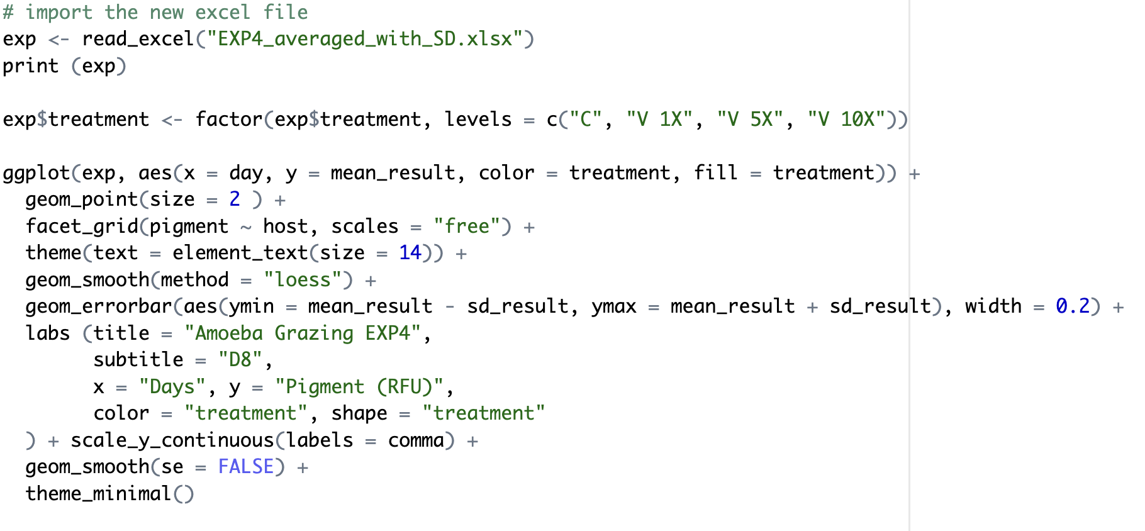
Visualization of growth curve - code

Slide 13

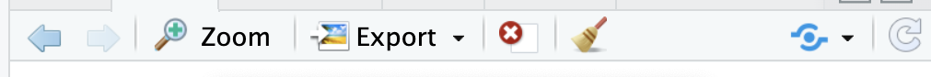
Visualization of growth curve - graph
Advantages - Free scale for presentation or high-resolution archive

Slide 14
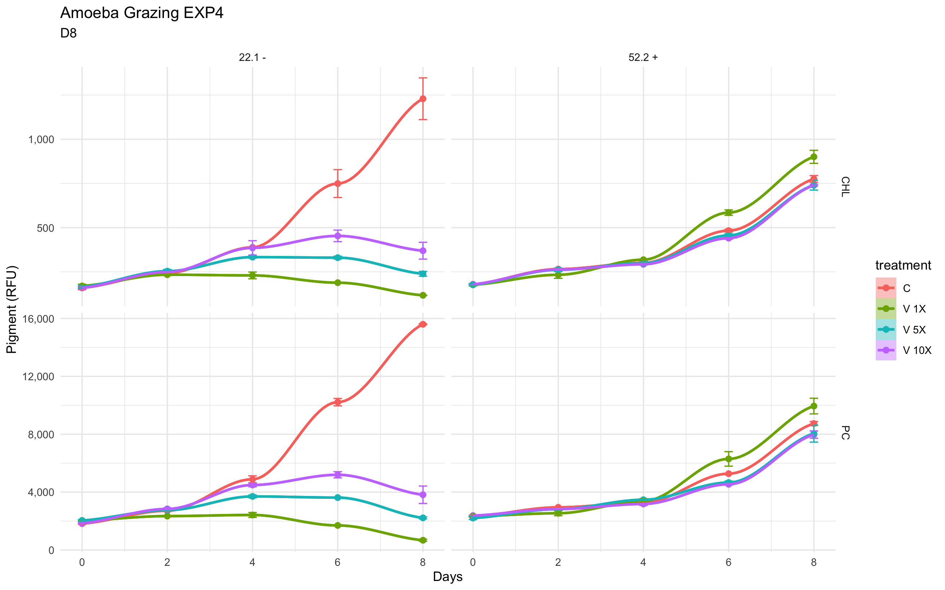

Slide 15
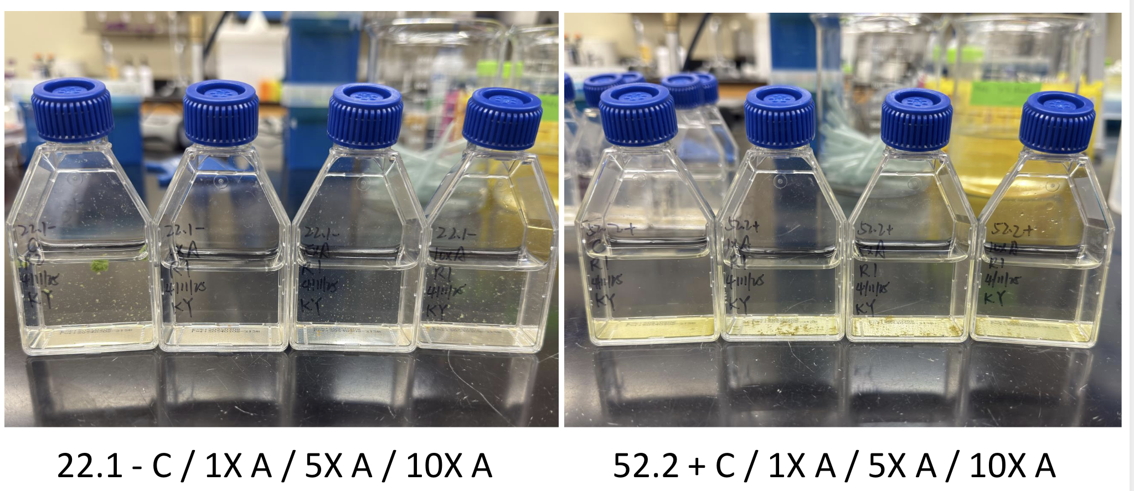
Visual observation

Slide 16

One-way ANOVA (treatment ~ host)
Purpose – within the same host (MC) if the mean pigments (biomass) under different treatments of Amoeba density significantly differ

Slide 17
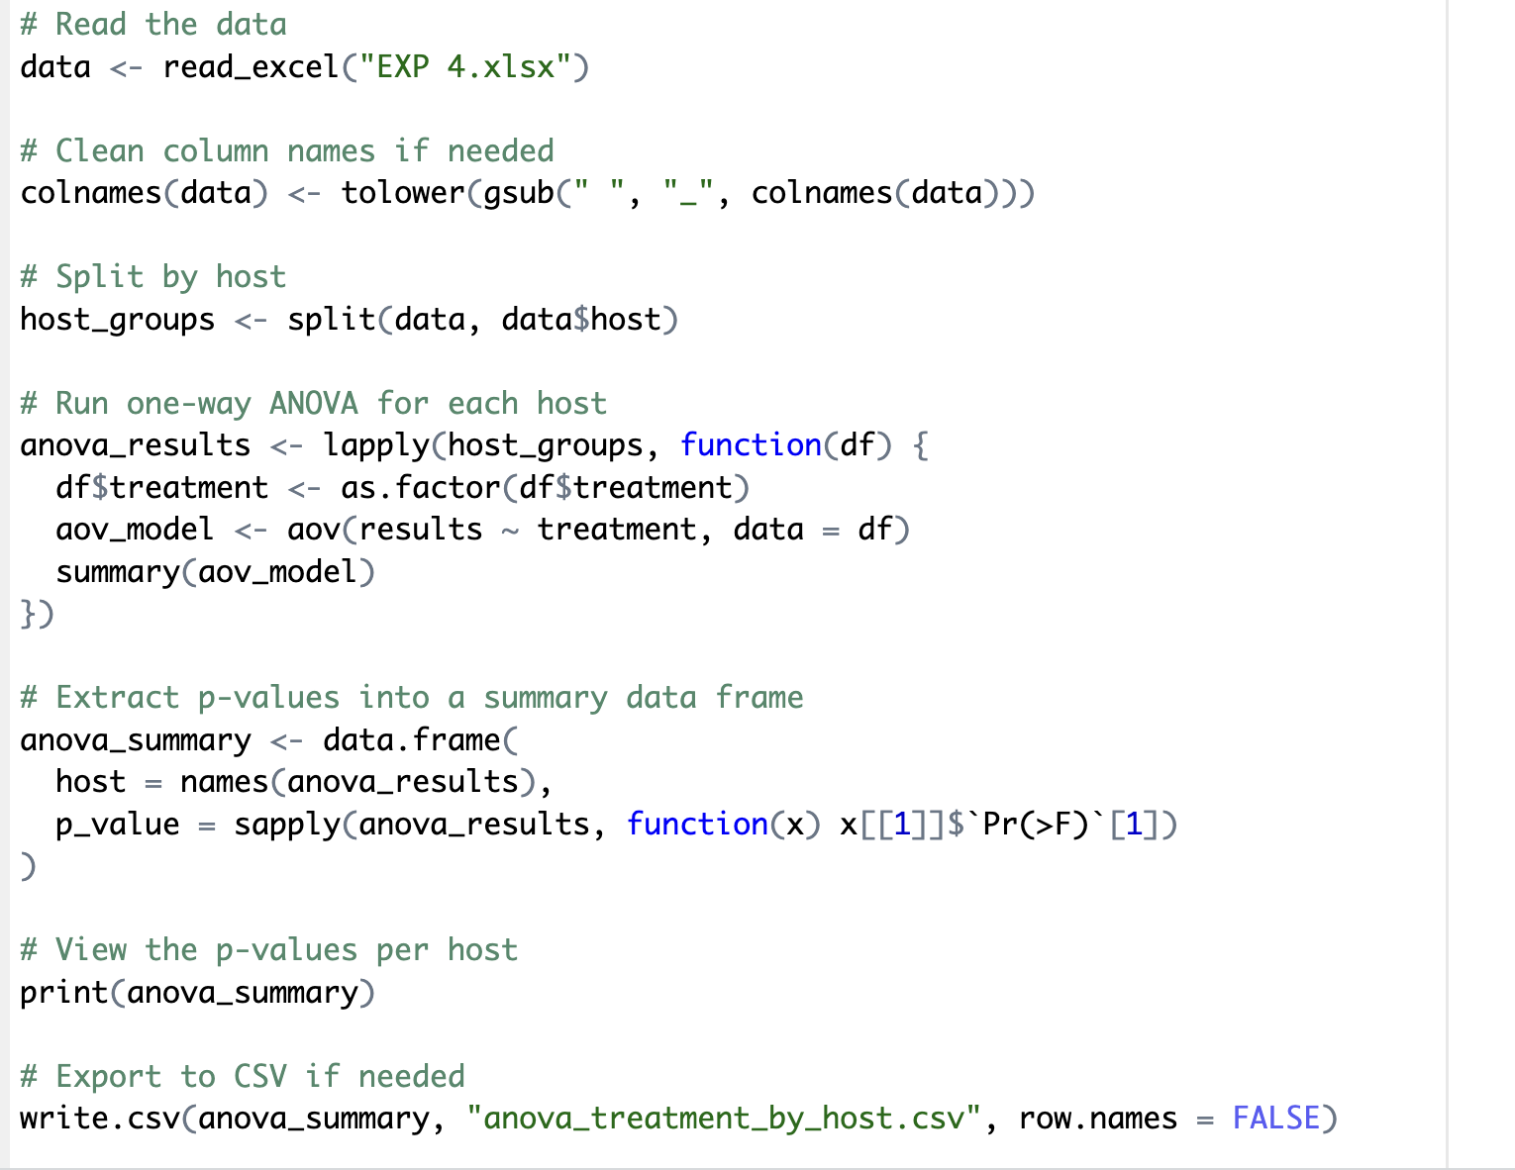
One-way ANOVA - codes

Slide 18
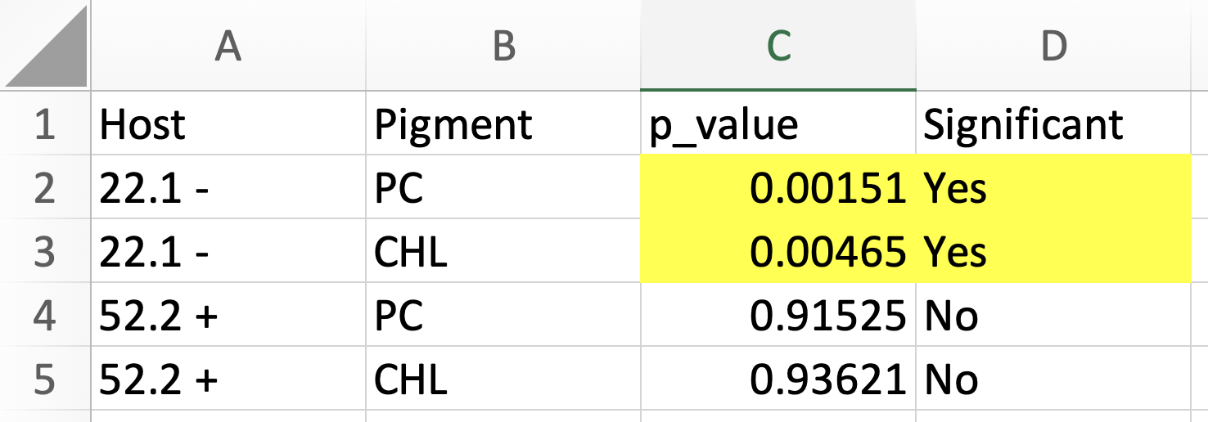
One-way ANOVA - results

Slide 19

Tukey HSD post-hoc test
Purpose – which are the significantly different treatment density?

Slide 20
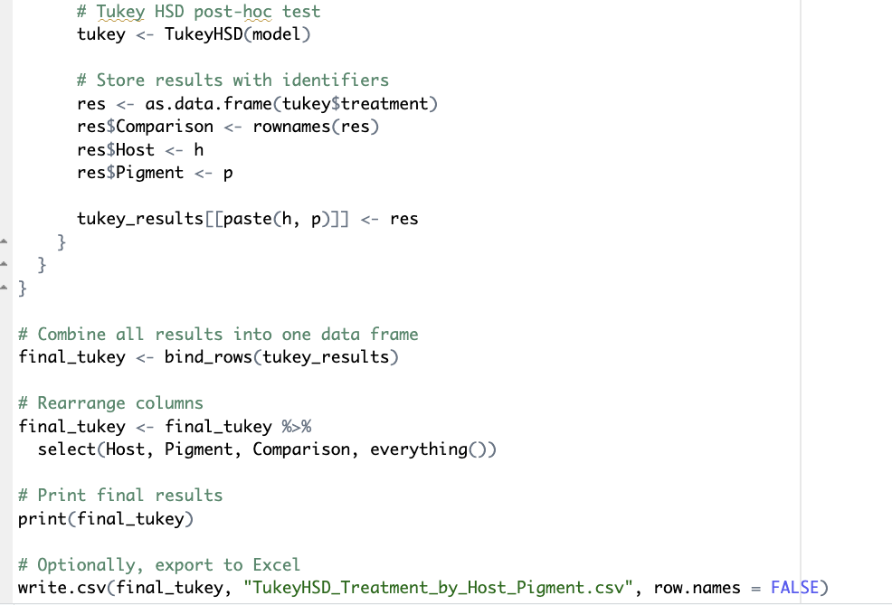
Tukey HSD post-hoc test – partial codes

Slide 21
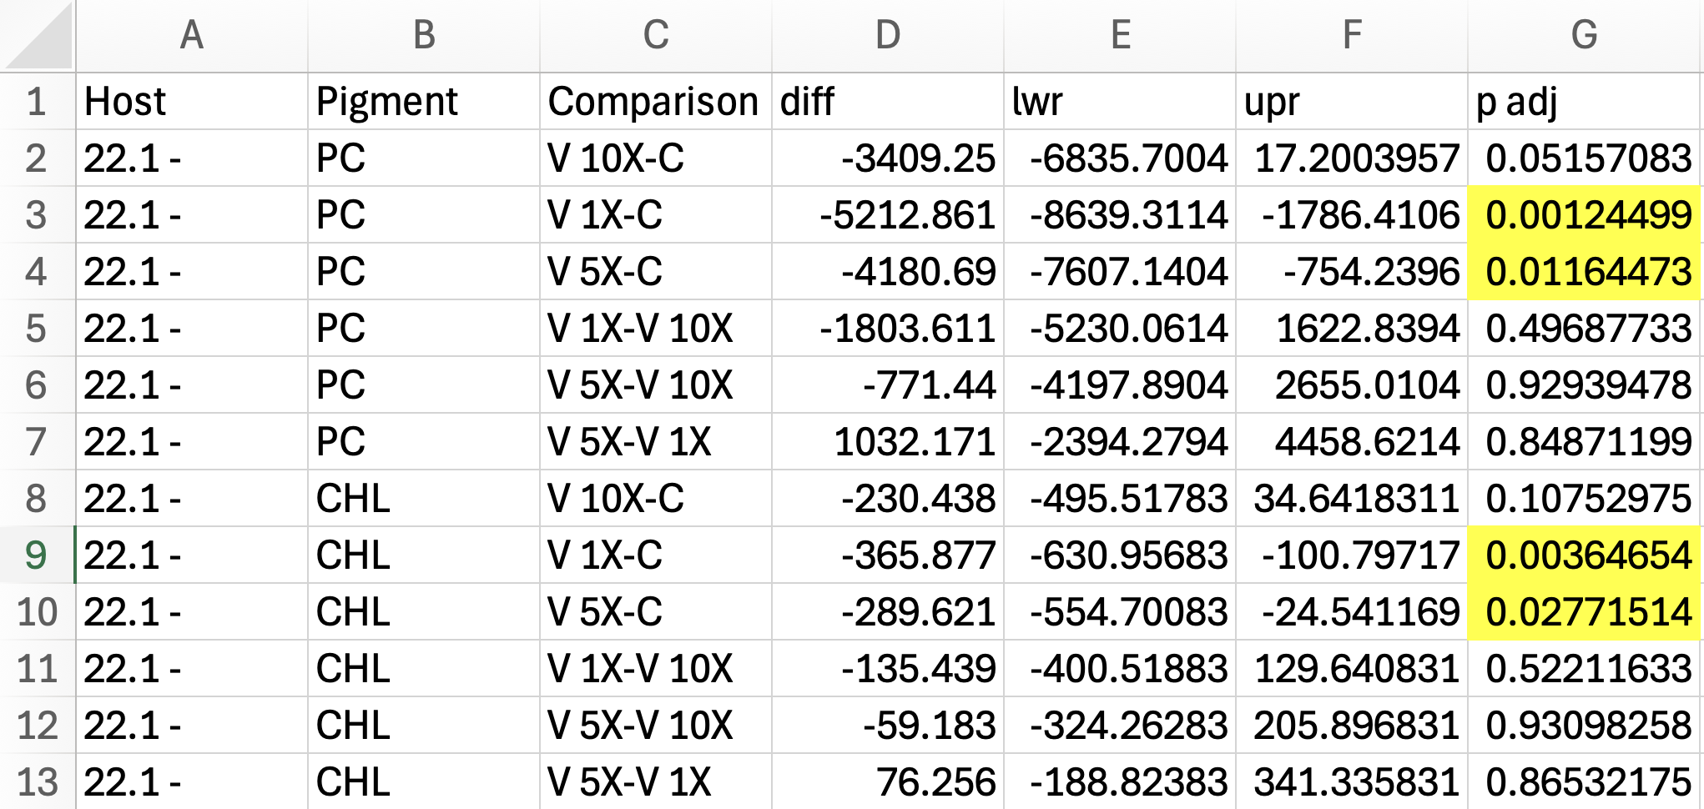
Tukey HSD post-hoc test – 22.1 - results

Slide 22
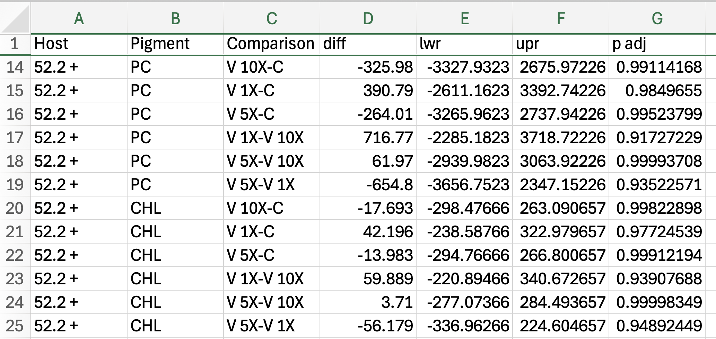
Tukey HSD post-hoc test – 52.2 + results

Slide 23
Conclusion and Improvement
MCs: Amoebae dependent to show control effect ; Amoebae independent with/ without control effect → needs genetic analysis
Cell count not included (how high is high, how low is low) → threshold
Daily measurement VS. Daily variation (growth rate)

Slide 24
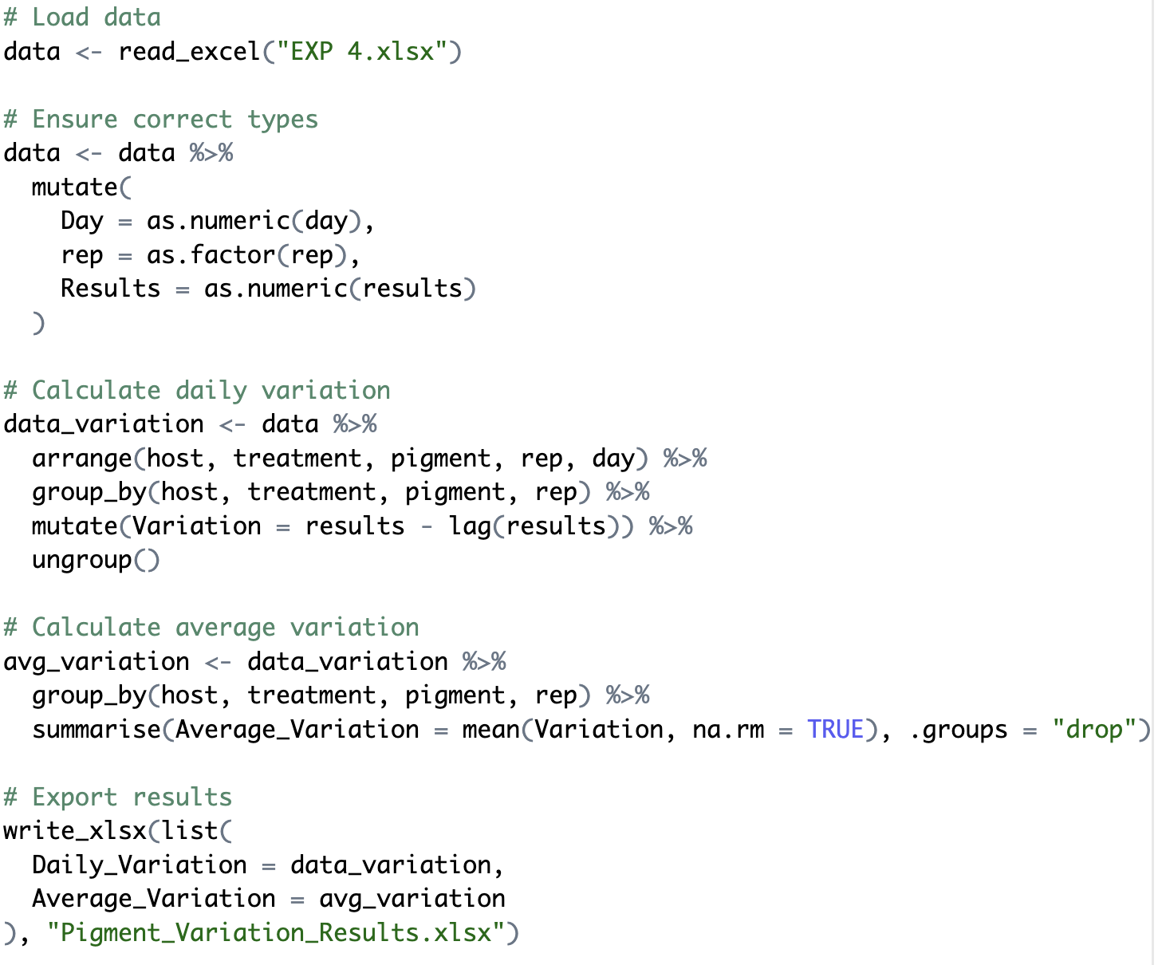

Slide 25
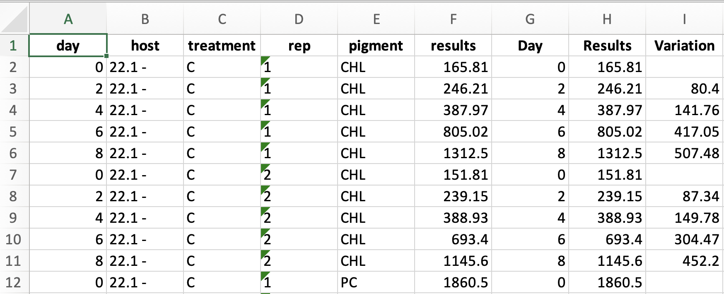
Daily variation (growth rate) will be applied in the future study

Slide 26

Future applications
Aim 2: Nutrient setting selective pressure (High/Low N:P)
Aim 3: Co-treatment with Algicide
More parameters: cell density / size, toxin level, gene expression

Slide 27
References
Urrutia-Cordero, P., Agha, R., Cirés, S., Lezcano, M. Á., Sánchez-Contreras, M., Waara, K.-O., Utkilen, H., & Quesada, A. (2013). Effects of harmful cyanobacteria on the freshwater pathogenic free-living amoeba Acanthamoeba castellanii. Aquatic Toxicology, 130–131, 9–17. https://doi.org/10.1016/j.aquatox.2012.12.019
Van Wichelen, J., D ’hondt, S., Claeys, M., Vyverman, W., Berney, C., Bass, D., & Vanormelingen, P. (2016). A Hotspot of Amoebae Diversity: 8 New Naked Amoebae Associated with the Planktonic Bloom-forming Cyanobacterium Microcystis. Acta Protozoologica, 55(2). https://doi.org/10.4467/16890027AP.16.007.4942ï
Van Wichelen, J., van Gremberghe, I., Vanormelingen, P., Debeer, A. E., Leporcq, B., Menzel, D., Codd, G. A., Descy, J. P., & Vyverman, W. (2010). Strong effects of amoebae grazing on the biomass and genetic structure of a Microcystis bloom (Cyanobacteria). Environmental Microbiology, 12(10), 2797–2813. https://doi.org/10.1111/j.1462-2920.2010.02249.x
Van Wichelen, J., van Gremberghe, I., Vanormelingen, P. (2012). The importance of morphological versus chemical defences for the bloom-forming cyanobacterium Microcystis against amoebae grazing. Aquat Ecol 46, 73–84. https://doi.org/10.1007/s10452-011-9382-8
Weger, H. G., Polasek, A. K., Wright, D. M., Damodaran, A., & Stavrinides, J. (2024). Grazing preferences of three species of amoebae on cyanobacteria and green algae. Journal of Eukaryotic Microbiology, 71(2). https://doi.org/10.1111/jeu.13018
Xinyao, L., Miao, S., Yonghong, L., Yin, G., Zhongkai, Z., Donghui, W., Weizhong, W., & Chencai, A. (2006). Feeding characteristics of an amoeba (Lobosea: Naegleria) grazing upon cyanobacteria: Food selection, ingestion and digestion progress. Microbial Ecology, 51(3), 315–325. https://doi.org/10.1007/s00248-006-9031-2

